Slide 1
Firebase Deploy

Slide 2
What is Firebase ?
Firebase is a mobile and web application platform with tools and infrastructure designed to help developers build high-quality apps.
Firebase is made up of complementary features that developers can mix-and-match to fit their needs.

Slide 3
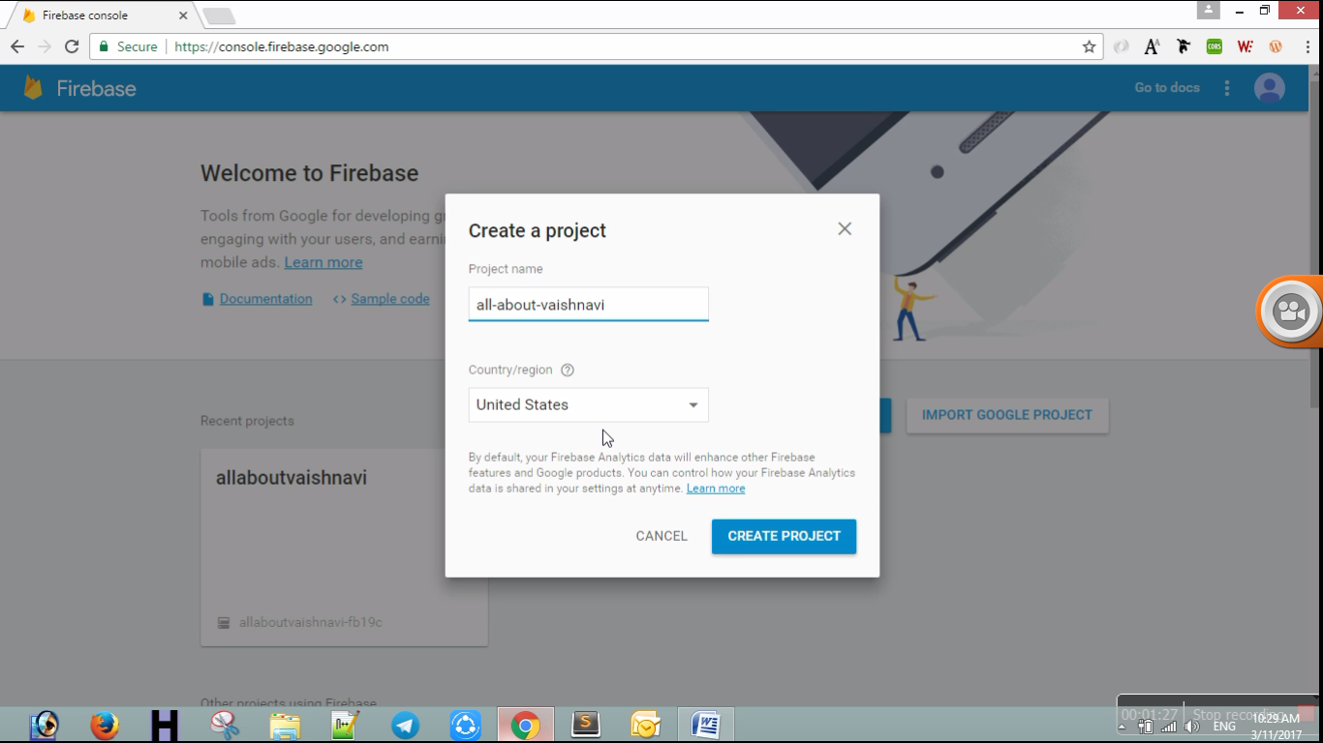
Project Setup
Step1 – First create one application in firebase console.
console.firebase.google.com

Slide 4
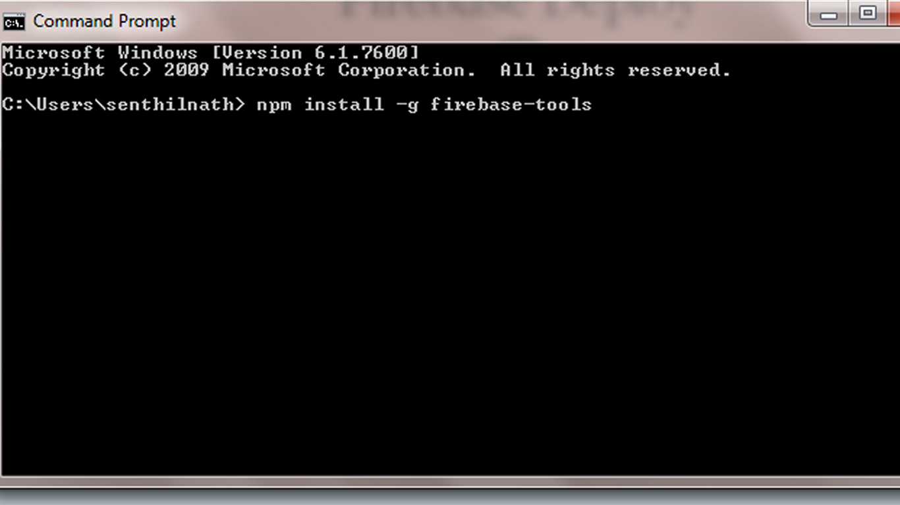
Project Setup
Step 2 – In command prompt, install firebase-tools globally using below command. npm install –g firebase-tools (if you done it already leave this step)

Slide 5
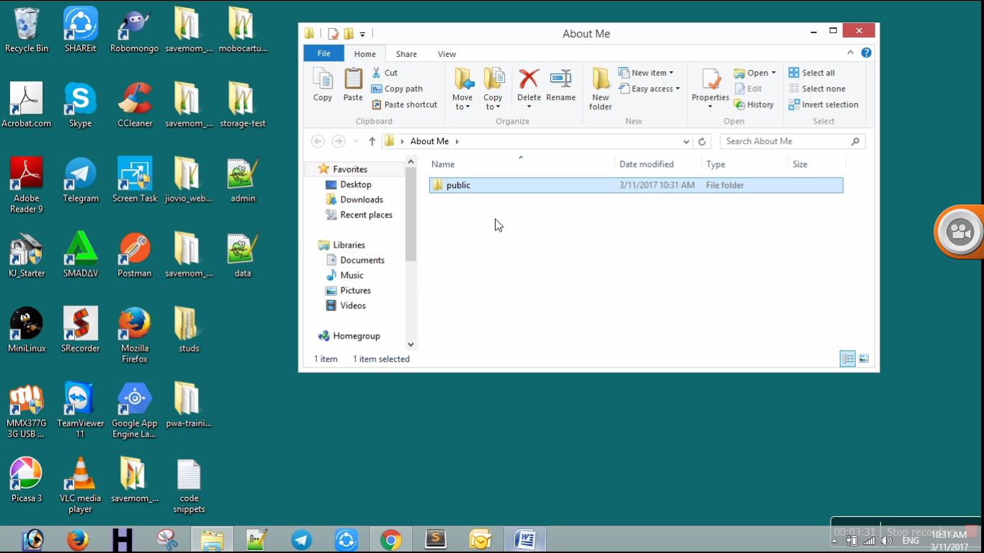
Project Setup
Step 3 – Goto your project folder.

Slide 6
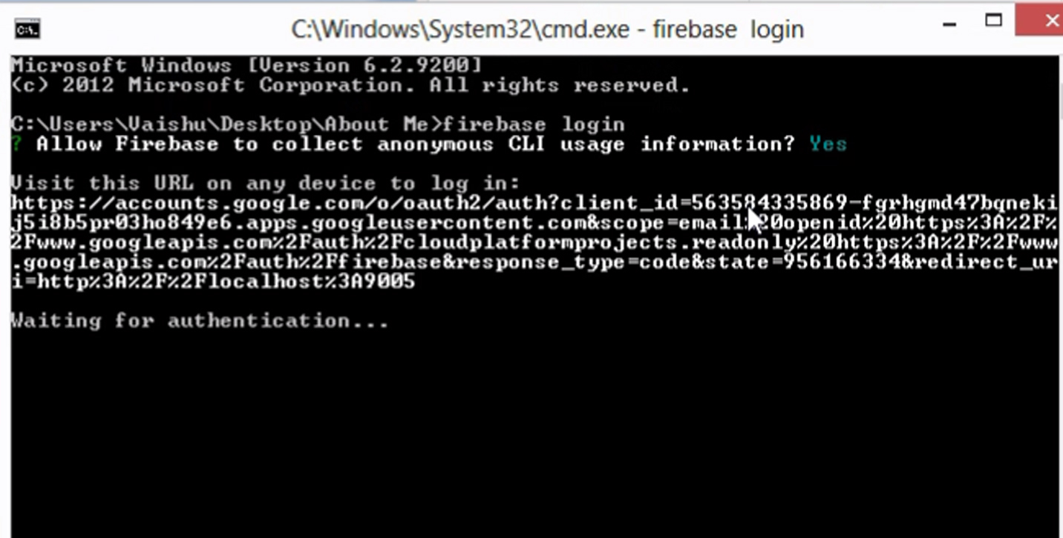
Project Setup
Step 4 – In command prompt, give the commands
firebase login (To login into your firebase account)

Slide 7
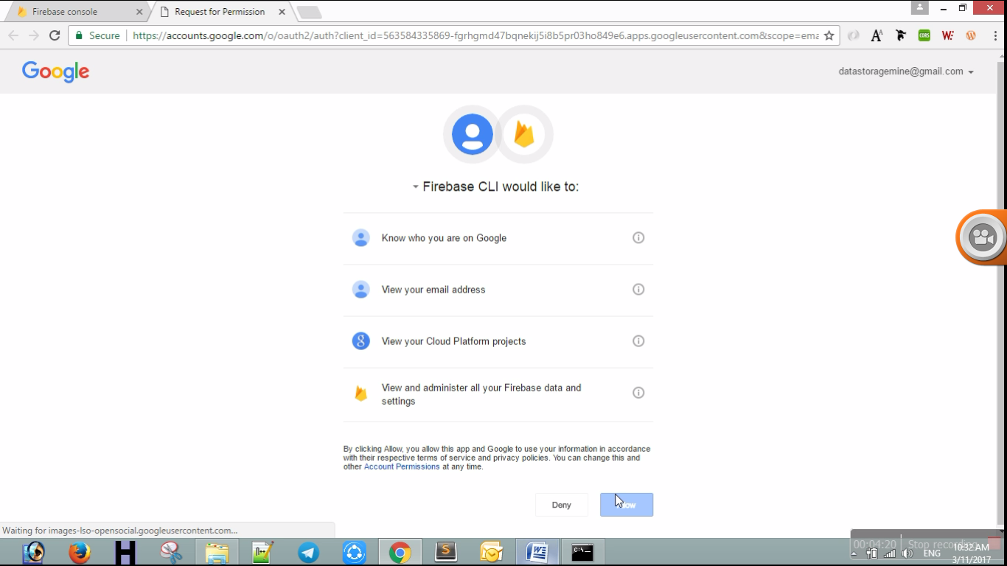
Project Setup

Slide 8
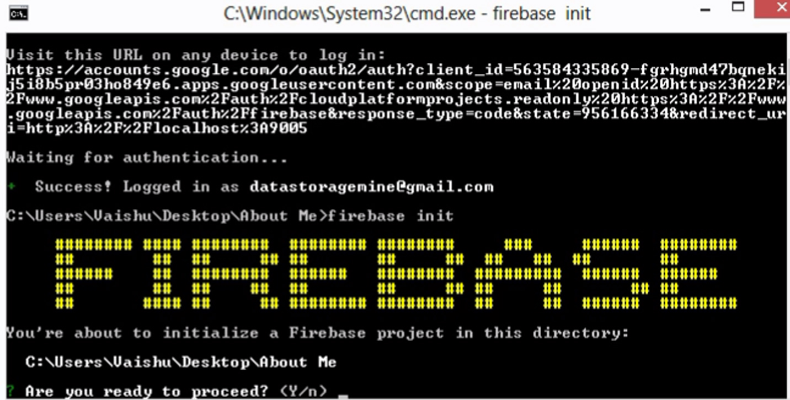
Project Setup
firebase init
Step 5 : This will ask the below questions:
Are you ready to proceed? (Y/n) Y

Slide 9
Project Setup
What Firebase CLI features do you want to setup for this folder? (Press <space> to select) (*) Database: Deploy Firebase Realtime Database Rules
(*) Hosting: Configure and deploy Firebase Hosting sites → Choose Hosting option
=== Project Setup

Slide 10
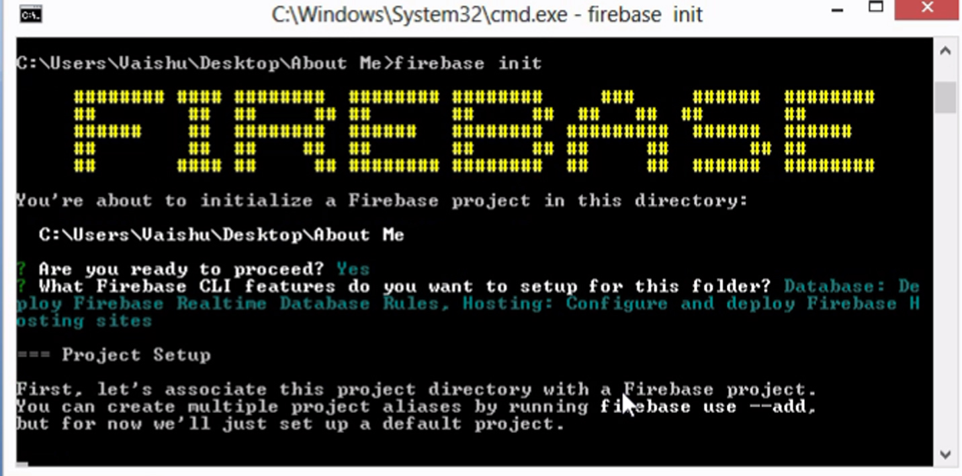
Project Setup

Slide 11
Database Setup
First, let's associate this project directory with a Firebase project.
You can create multiple project aliases by running firebase use --add,
but for now we'll just set up a default project.
? What Firebase project do you want to associate as default? (Use arrow keys)
[don't setup a default project] → Select the project you created before.

Slide 12
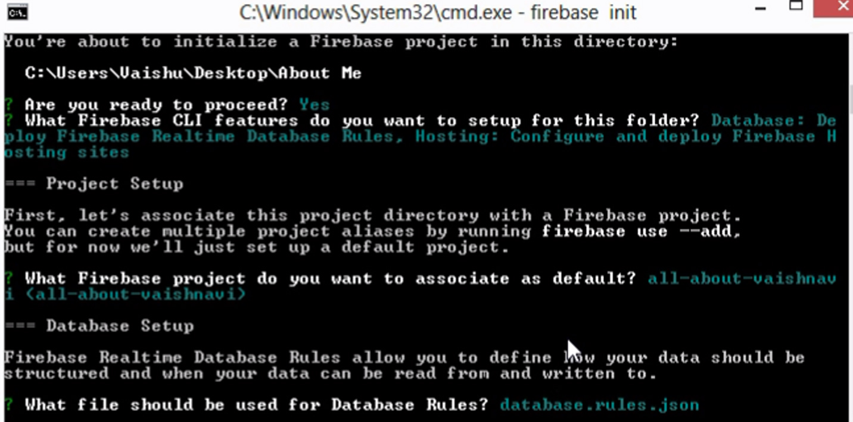
Database Setup
Firebase Realtime Database Rules allow you to define how your data should be structured and when your data can be read from and written to.
? What file should be used for Database Rules? (database.rules.json)
→click enter

Slide 13
Hosting Setup
Your public directory is the folder (relative to your project directory) that
will contain Hosting assets to uploaded with firebase deploy. If you
have a build process for your assets, use your build's output directory.
? What do you want to use as your public directory? (public)
→Give public folder of your project(ex: www)
? Configure as a single-page app (rewrite all urls to /index.html)? (y/N) → (give y if your app is SPA otherwise give N)
? File www/index.html already exists. Overwrite? (y/N)→ give N
That’s it. Your initialization process has been completed.

Slide 14
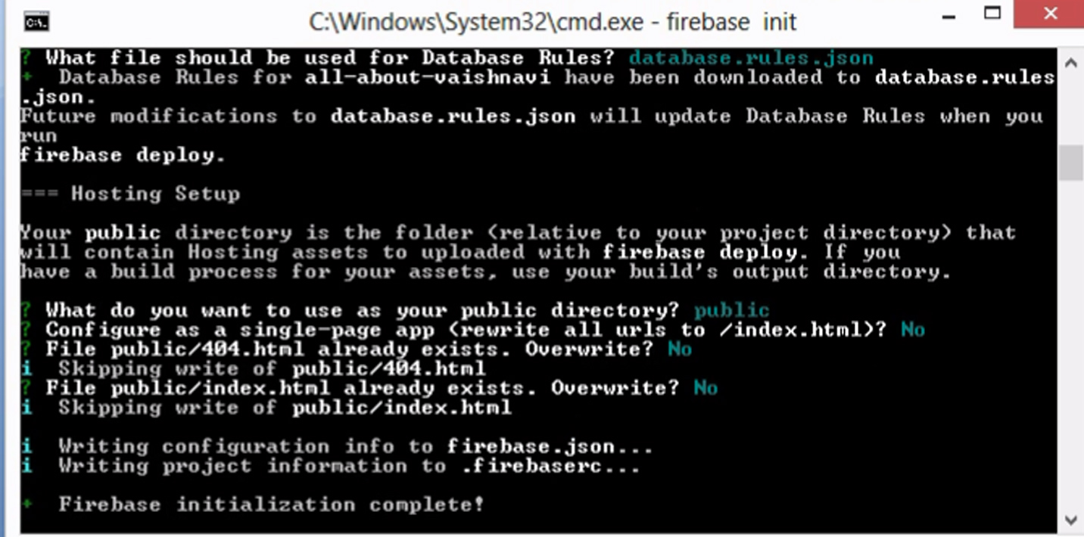
Hosting Setup

Slide 15
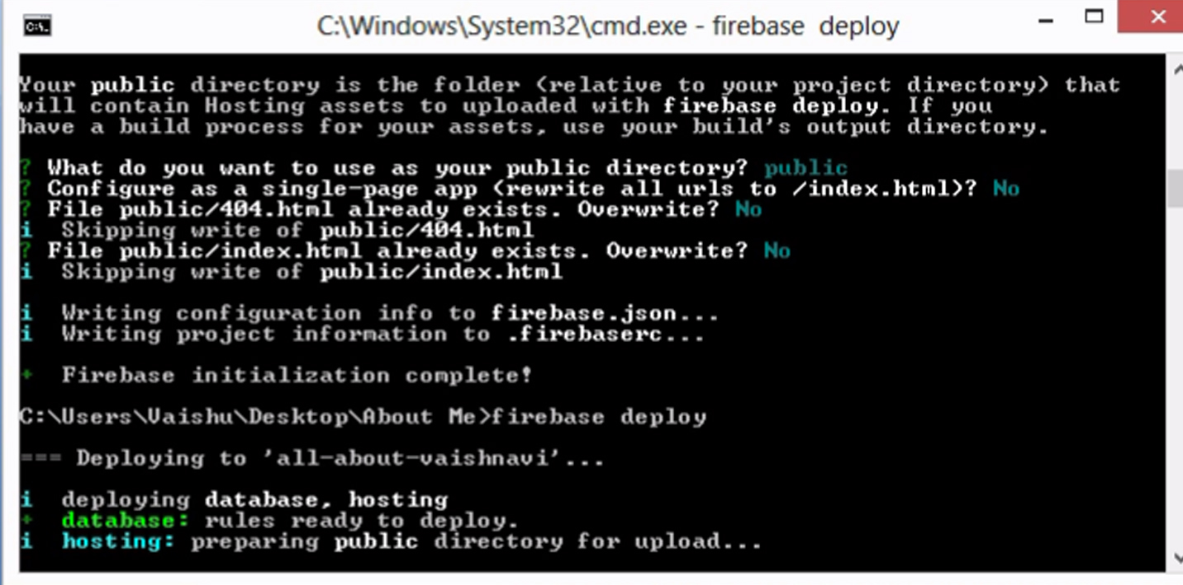
Hosting Setup
Step 6 : Finally give,
Firebase deploy to deploy your webapp in firebase.

Slide 16
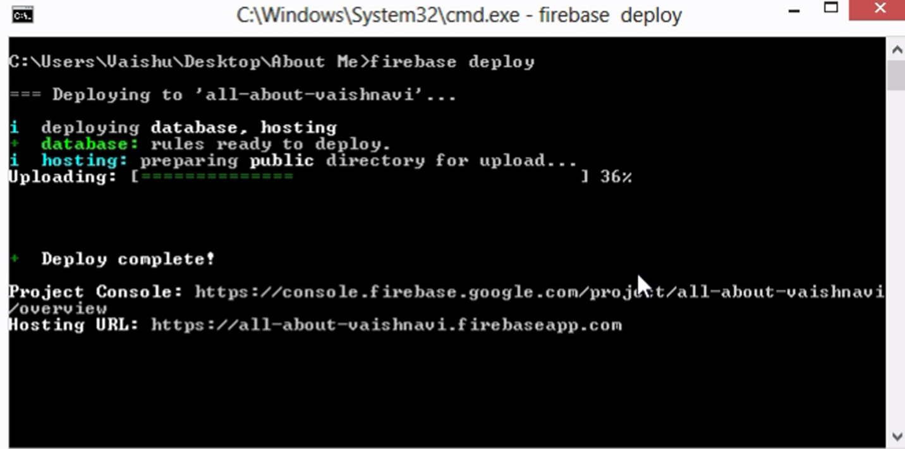
Hosting Setup
Deploy Completed
My URL is : all-about-vaishnavi.firebaseapp.com

Slide 17
Thank You !

